Slide 1
Salary Prediction using Machine Learning

Slide 2
TABLE OF CONTENTS
01
02
03
04
05
Linear Regression
Introduction
Task Overview
Model Deployment
Future Scope

Slide 3
INTRODUCTION
Predicting Data Professional Salaries: A Critical Challenge
In the dynamic field of data professions, salaries exhibit significant variability influenced by factors like experience, job role, and performance. Accurate salary prediction is crucial for:
Job seekers navigating career decisions
Employers striving to attract and retain top talent
Our project addresses this challenge, aiming to develop a reliable model for forecasting data professional salaries.

Slide 4
Problem Statement and it’s solution
Problem Statement:
Salaries in the field of data professions vary widely based on factors such as experience, job role, and performance. Accurately predicting salaries for data professionals is essential for both job seekers and employers.
Solution:
Develop a data-driven salary prediction model using the best accuracy providing ML algorithm.
Incorporate key factors: experience, past experience, job, and ratings.
Utilize machine learning algorithms for precise forecasting
Benefits:
Informed career decisions for professionals
Improved transparency in the data job market

Slide 5
Overview on Linear Regression
Linear Regression is a fundamental statistical technique used to model the relationship between a dependent variable and one or more independent variables. It assumes a linear connection between these variables and aims to find the best-fitting straight line through the data points. This line is then used to predict the value of the dependent variable for new inputs. Linear Regression is widely applied due to its simplicity, interpretability, and effectiveness in capturing straightforward relationships in data. It forms the basis for more complex predictive models and is commonly used in fields like economics, finance, and scientific research.

Slide 6
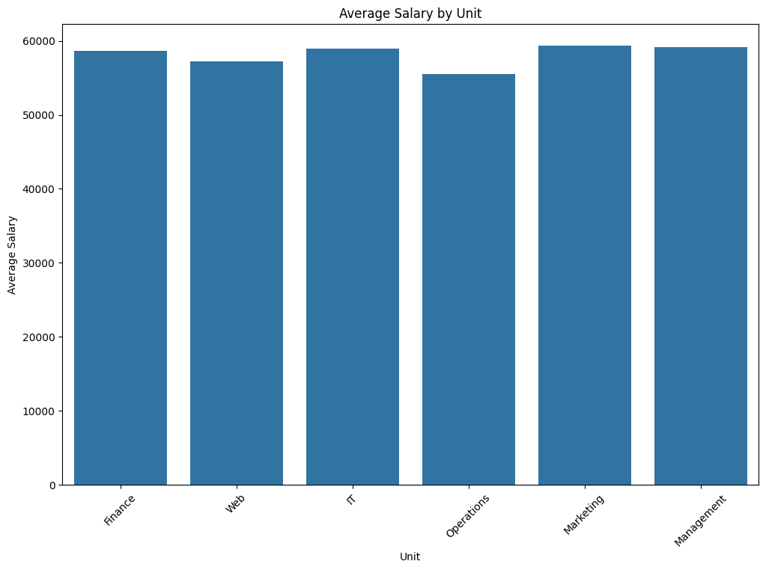
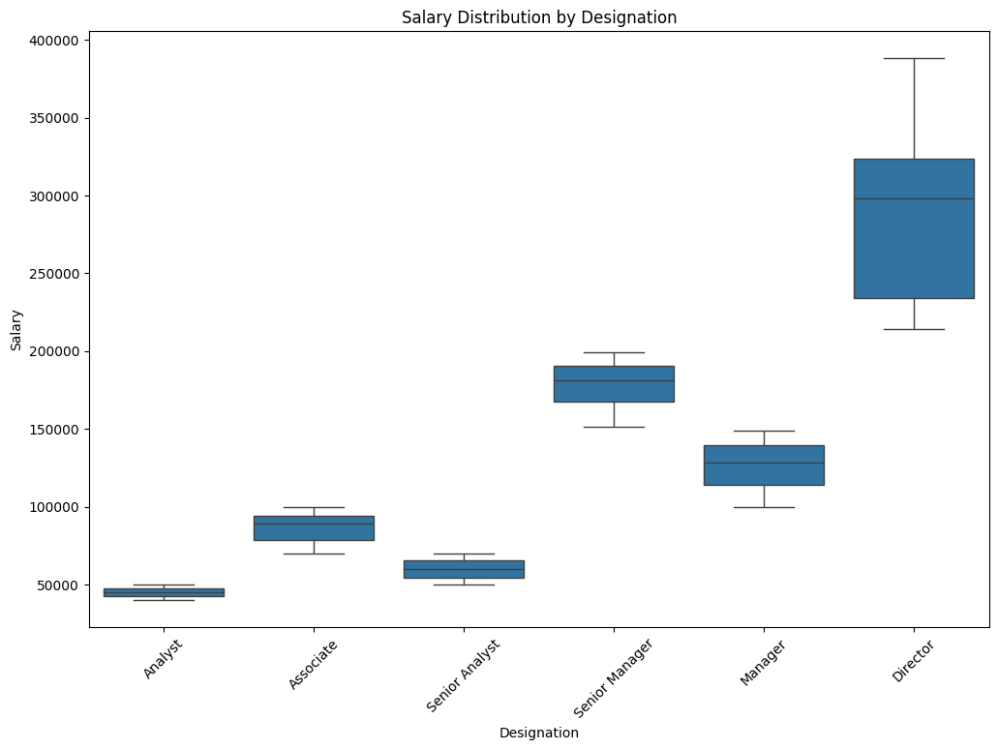
Visualization using a cleaned Dataset
Bar Plot
Box Plot

Slide 7
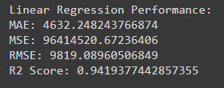
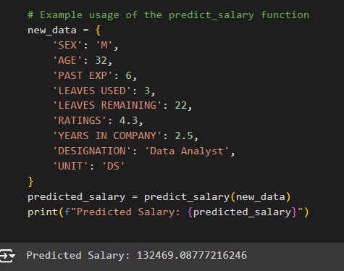
Model Deployment
Once the Model provided around 95% accuracy , it is deployed using Flask
Accuracy Metrics: Prediction using Dummy Data:

Slide 8
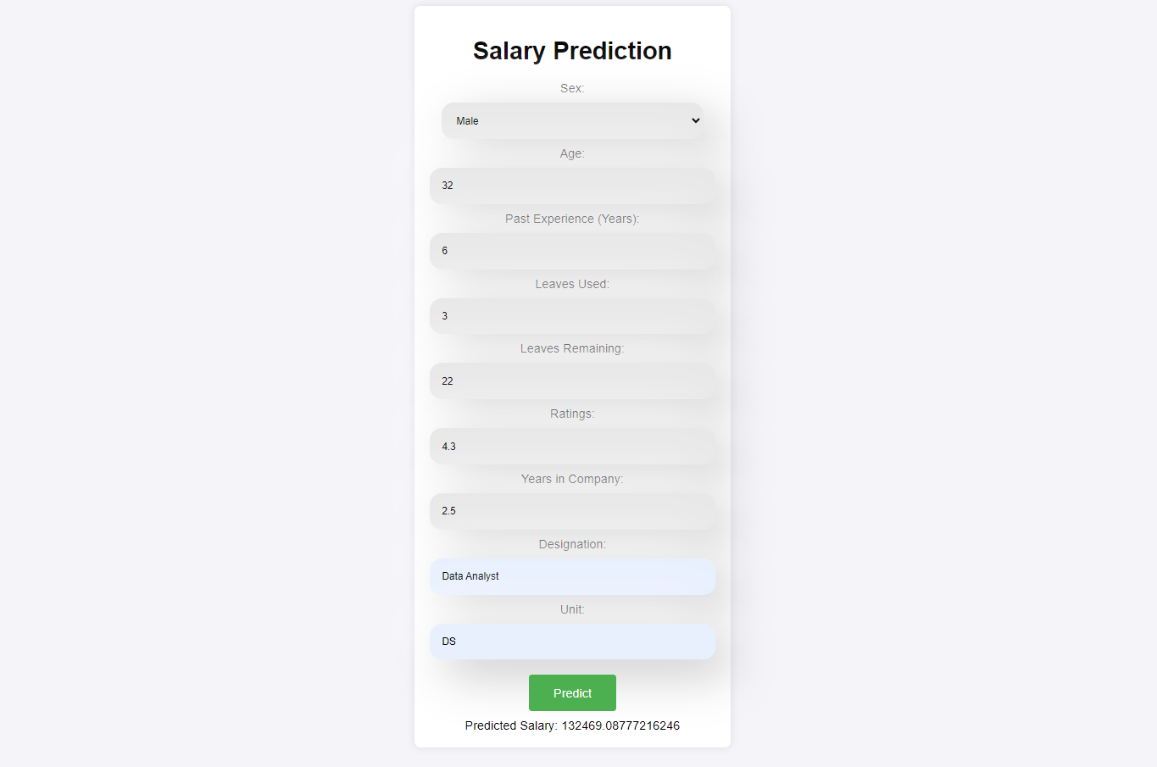
DEPLOYMENT USING FLASK(Slight changes using HTML & CSS)

Slide 9
Future Scope
The future scope of the salary prediction project is vast and promising. Key enhancements include integrating real-time data from job boards and APIs for dynamic updates, exploring advanced machine learning algorithms for improved accuracy, and incorporating additional features like educational background and geographic location. Enhancing user experience through interactive dashboards and visualization tools, ensuring data security and compliance, and deploying on cloud platforms for scalability are crucial steps. Expanding the model to provide global market analysis and sector-specific insights, alongside incorporating feedback mechanisms for continuous improvement, will significantly broaden the application's utility. Additionally, features such as career path recommendations and salary negotiation tips can further empower users, making the application a comprehensive tool for data professionals and employers.

Slide 10
THANK YOU

